Slide 1
Banking Application
Console based
Sukumar Tusam
09.07. 2023

Slide 2
Introduction
The objective of this project is to develop a basic banking application that allows users to perform essential banking operations such as checking their account balance, making deposits, and withdrawing funds.
The application is implemented using the Java programming language, utilizing various fundamental concepts and features.
In this presentation, we will walk you through the key functionalities of the banking application and provide an overview of the programming techniques and concepts used.
By the end of this presentation, you will have a clear understanding of how the application works and how different programming elements come together to deliver a functional banking solution.

Slide 3
Project Requirements
The Simple Banking Application project has several requirements that guided its development like ;
User Input using Scanner class: The application should be able to accept user input for various operations, such as entering the account number, selecting an action, and providing transaction details
Basic String Operations: The project involves working with strings to handle user input.
Conditional Statements (if/else/ switch ): Conditional statements are used to control the flow of the program based on certain conditions.
Methods : To implement all The functionality which is required.
Loops : Loops are used to repeat a certain block of code until a specific condition is met.
IDE : e.g. Eclipse : To write Java code .

Slide 4
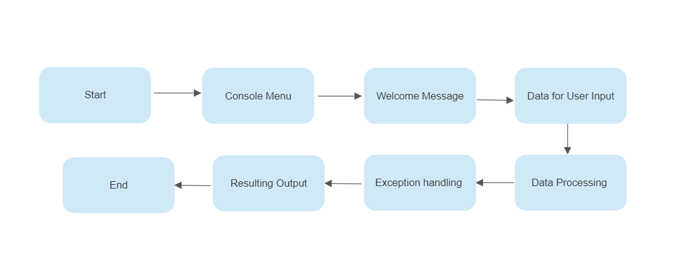
Architecture
The system design of the Simple Banking Application comprises several components that work together to provide a seamless banking experience. Like

Slide 5
Architecture Details
Data for User input : Here we are using Scanner class in java to take user input like entering amount, deposit amount etc.
Data Processing : After user input , the data will be processed for further outputs.
Exception Handling : For invalid data / inputs , the required exception will be generated by the programmer for smoothful termination of the program.
Output : After exception handling and Data processing , the output will be shown on console menu.

Slide 6
Functionality
The bank application contains the following functionality ;
Register
Create username and password
Logging In
Check Balance
Deposit
Withdraw
Exit

Slide 7
Functionality Details
Check Balance :The "Check Balance" functionality allows users to view their current account balance.
Logic behind the "Check Balance" feature:
User selects the "Check Balance" option from the menu.
The application retrieves the account balance from the account management module.
The balance is displayed to the user using the print statement .

Slide 8
Deposit : The "Deposit" functionality allows users to add funds to their account.
Logic behind the "Deposit" feature:
User selects the "Deposit" option from the menu.
The application prompts the user to enter the amount to be deposited.

Slide 9
Withdraw : The "Withdraw" functionality allows users to withdraw funds from their account.
Logic behind the "Withdraw" feature:
User selects the "Withdraw" option from the menu.
The application prompts the user to enter the amount to be withdrawn.
The entered amount is validated to ensure it is a positive number and does not exceed the account balance.
The transaction module updates the account balance by deducting the withdrawal amount.
The updated balance is displayed to the user.

Slide 10
Exit : The "Exit" functionality allows users to exit the banking application.
Logic behind the "Exit" feature:
User selects the "Exit" option from the menu.
The application displays a farewell message or confirmation.
The program terminates, ending the user's session.

Slide 11
Future Enhancement
The Simple Banking Application project can be enhanced further to provide additional features and improvements. Some potential future enhancements include:
User Authentication: Implement a secure login system to ensure only authorized users can access their accounts.
Transfer Funds: Enable users to transfer funds between their own accounts or to other users.
Transaction History: Maintain a detailed transaction history to allow users to review their past transactions.
User Interface Enhancements: Improve the user interface with better design, graphical elements, and user-friendly prompts.
Multi-User Support: Implement multi-user functionality to accommodate multiple users accessing the application simultaneously.
Security Enhancements: Implement encryption and secure data storage mechanisms to protect sensitive user information.

Slide 12
Conclusion
In conclusion, the Simple Banking Application project provides a foundation for a basic banking solution.
The project demonstrates the use of these fundamental programming concepts to create real-world applications.
Future enhancements can be implemented to further improve the functionality, security, and user experience of the application.

Slide 13
References
Here are some references and resources used during the development of the Simple Banking Application project:
[Book] "Java: A Beginner's Guide" by Herbert Schildt
[Online Tutorial] "Java Tutorials" by Oracle
[Documentation] Java SE Documentation by Oracle
[Online Platform] Stack Overflow for troubleshooting and code examples
[Online Platform] GitHub for version control and code hosting

Slide 14
Thank You

